Slide 1
SCSA1304
ADVANCED DATA STRUCTURES
B.E CSE 2019-2023
III SEMESTER

Slide 2
COURSE OBJECTIVES
➢ To acquire knowledge of organizing the data in non
linear fashion.
➢ To get the idea of balancing the height of trees to
optimize the structure and search time.
➢ To learn the process of establishing the network with
various nodes with minimum cost and finding the
shortest path.
➢ To understand the method of designing the table
data structure and its applications.

Slide 3
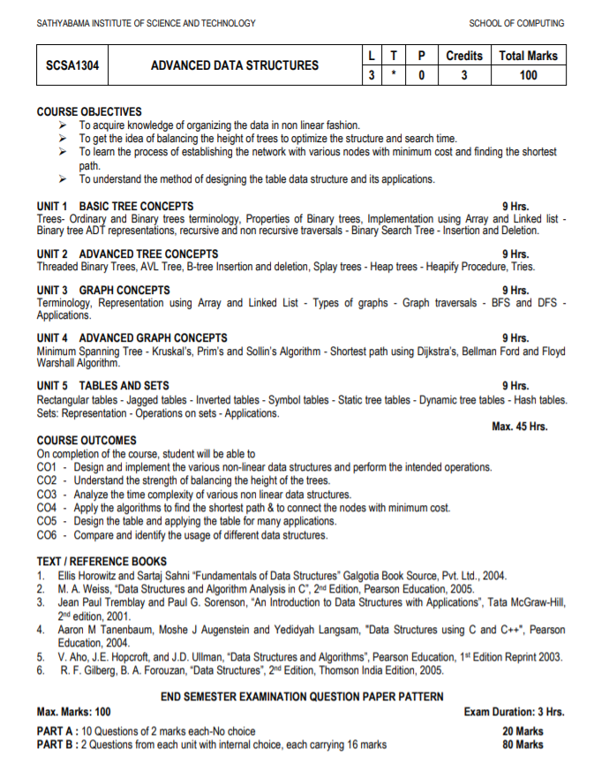

Slide 4
UNIT V
1
TABLES
Rectangular Tables
Jagged Tables
Inverted Tables
Symbol Tables
Static Tree Tables
Dynamic Tree Tables
Hash Tables
2
SETS
Representation
Operations
Applications

Slide 5
Tables
TABLES
Plays a significant role in information retrieval
Consider the keys :
K₁, K₂, K₃ , ……….K_{n}
To find a record with a given key value, k, access the index by its key.
Example:
Value | This | is | a | table | example | in | data | Structures
Key | 0 | 1 | 2 | 3 | 4 | 5 | 6 | 7
Notes:
Table is a data structure which plays a significant role in information retrieval.
A set of n distinct records with keys K1, K2, …., Kn are stored in a file.
If we want to find a record with a given key value, K, simply access the index given by its key k.

Slide 6
Table T
TABLE - TYPES
Rectangular Tables
Jagged Tables
Inverted Tables
Symbol Tables
Static Tree Tables
Dynamic Tree Tables
Hash Tables
Notes:
The table lookup has a running time of O(1).
The searching time required is directly proportional to the number of number of records in the file.
This searching time can be reduced, even can be made independent of the number of records, if we use a table called Access Table.

Slide 7
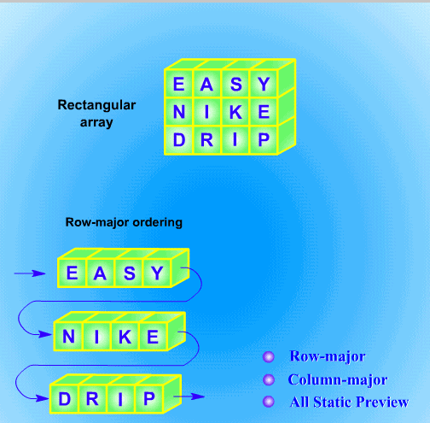
Rectangular Tables
RECTANGULAR TABLES
2D Tables with Rows and Columns
Example: Arrays
Rectangular Tables are otherwise referred as “MATRIX”
Arrays
Row Major
Column Major
Notes:
Tables are very often in rectangular form with rows and columns.
Most programming languages accommodate rectangular tables as 2-D arrays.
Rectangular tables are also known as matrices.
Almost all programming languages provide the implementation procedures for these tables as they are used in many applications.

Slide 8
Row Major Arrangement (Linear)
Row Major Arrangement (Linear)
D | A | T | A | H | A | S | H | T | W | O | D
0 |  |  | n-1 | n |  |  | 2n-1 | 2n |  |  | 3n-1
Row1 |  |  |  | Row2 |  |  |  | Row3
For an m X n array (m rows and n columns)
Each row is indexed from 0 to m – 1 and each column is indexed
from 0 to n – 1.
Notes:
Logically, a matrix appears as two-dimensional, but physically it is stored in a linear fashion.
In order to map from the logical view to physical structure, an indexing formula is used.
The compiler must be able to convert the index (i, j) of a rectangular table to the correct position in the sequential array in memory.

Slide 9
RECTANGULAR TABLES
Rectangular Tables
Row Major Order
3 x 4 Rectangular Table
Row Major Order
 | 1 | 2 | 3 | 4
1 | D | A | T | A
2 | H | A | S | H
3 | T | W | O | D
D | A | T | A | H | A | S | H | T | W | O | D
1 | 2 | 3 | 4 | 5 | 6 | 7 | 8 | 9 | 10 | 11 | 12
Column Major Order
Column Major Order
D | H | T | A | A | W | T | S | O | A | H | D
1 | 2 | 3 | 4 | 5 | 6 | 7 | 8 | 9 | 10 | 11 | 12
 | 1 | 2 | 3 | 4
1 | D | A | T | A
2 | H | A | S | H
3 | T | W | O | D
For an m X n array (m rows and n columns)
Each row is indexed from 0 to m – 1 and each column is indexed from 0 to n – 1.
Notes:
Logically, a matrix appears as two-dimensional, but physically it is stored in a linear fashion.
In order to map from the logical view to physical structure, an indexing formula is used.
The compiler must be able to convert the index (i, j) of a rectangular table to the correct position in the sequential array in memory.

Slide 10
Row & Column Major Order
ROW & COLUMN MAJOR ORDER
D | A | T | A | H | A | S | H | T | W | O | D
Row Major Order :
Assume that the base address is the first location of the memory.
Address of a_{ij} = store all the elements in the first (i-1)^{th} rows +
the number of elements in the i^{th} row up to the j^{th} column.
= ( i – 1 ) * n + j
Column Major Order
Address of a_{ij} = store all the elements in the first (j-1)^{th} column +
the number of elements in the j^{th} column up to the i^{th} rows.
= ( j – 1 ) * m + i
1 | 2 | 3 | 4 | 5 | 6 | 7 | 8 | 9 | 10 | 11 | 12
D | H | T | A | A | W | T | S | O | A | H | D
1 | 2 | 3 | 4 | 5 | 6 | 7 | 8 | 9 | 10 | 11 | 12

Slide 11
Jagged Table
JAGGED TABLE
Special kind of
Sparse Matrices.
Triangular Matrices
Band Matrices
In the jagged table, the elements in a row or a column (present) should be contiguous.
Notes:
Jagged tables are a special kind of sparse matrices such as triangular matrices, band matrices, etc…
In the jagged tables, we put a restriction that in the row (or in a column) if elements are present then they are contiguous.
Jagged array is array of arrays such that member arrays can be of different sizes,
i.e., we can create a 2-D arrays but with variable number of columns in each row.
These type of arrays are also known as Jagged arrays.

Slide 12
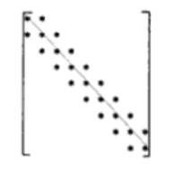
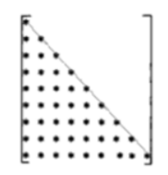
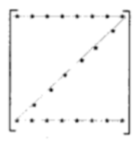
Examples
JAGGED TABLE
* | *
* | * | *
 | * | * | *
 |  | * | * | *
 |  |  | * | *
 |  |  |  | *
*
* | *
* | * | *
* | * | * | *
* | * | * | *
* | * | * | * | *
* | * | * | * | *
 |  |  | *
 |  | *
 | *
* | * | * | * | *

Slide 13
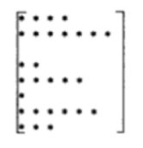
JAGGED TABLE
* | * | * | *
* | * | * | * | * | *
* | * | * | *
* | * | * | * | * | *
* | * | * | *
* | * | * | * | * | *
- | - | * | * | - | -
* | * | - | - | * | *
- | - | * | * | - | -
* | * | - | - | * | *
- | - | * | * | - | -
* | * | - | - | * | *

Slide 14
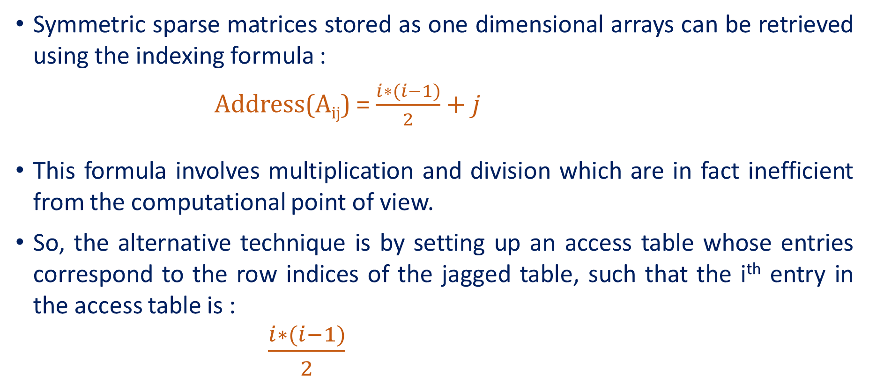
JAGGED TABLE
Symmetric sparse matrices stored as one dimensional arrays can be retrieved using the indexing formula :
Address(A_{ij}) = $\frac{i∗(i−1)}{2}+j$
This formula involves multiplication and division which are in fact inefficient from the computational point of view.
So, the alternative technique is by setting up an access table whose entries correspond to the row indices of the jagged table, such that the i^{th} entry in the access table is :
$\frac{i∗(i−1)}{2}$

Slide 15
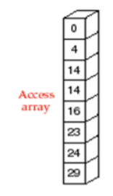
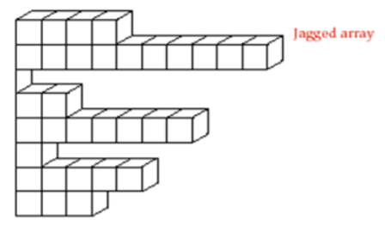
ACCESS TABLE
Examples
Examples
Calculated only once at the time of initiation, Stored in memory
Could be referred each time while accessing elements in the jagged table.
Requires only addition
0, 1, (1 + 2), (1 + 2) + 3, …
Notes:
We can also calculate by pure addition rather than multiplication or division such as 0,1, (1+2), (1+2)+3,…

Slide 16
ACCESS TABLE
Example
I
H | E
S | H | E
Y | O | U | R
T | H | E | I | R
M | Y | S | E | L | F
I | H | E | S | H | E | Y | O | U | R | T | H | E | I | R | M | Y | S | E | L | F
Jagged Table
Access Table
Row Major Order
I | H | E | S | H | E | Y | O | U | R | T | H | E | I | R | M | Y | S | E | L | F
1 | 0
2 | 1
3 | 3
4 | 6
5 | 10
6 | 15
Access Table A₅₄ :
5th Row, 4th Col
5th Location in access table = 10
Desired element = 4
Location = 10 + 4 = 14
Value = “I”
Notes:
For e.g., if we want to access a54 (element in 5th row and 4th column) then at 5th location of the access table, we see the entry is 10; hence desire element is at 14 (=10+4) location of the array which contains the elements. It is assumed that the 1st element of the table is located at the location of the array.

Slide 17
Example
0 |  | * | * | * | *
4 |  | * | * | * | * | * | *
10
10 |  | * | * | * | *
14 |  | * | * | * | * | * | *
20
20 |  | * | * | * | *
24 |  | * | * | * | * | * | *
Exercises
 |  |  |  |  |  | *
 |  |  |  |  | * | * | *
 |  |  |  | * | * | * | * | *
 |  |  | * | * | * | * | * | * | *
…………..
* | * | … | * | * | * | * | * | * | … | * | *
* | * | * | * | *
 |  |  | *
 |  | *
 | *
* | * | * | * | *

Slide 18
Inverted Table
INVERTED TABLES
With Inverted Tables:
Retrieve the records based on any field in sorted order
Inverted Table maintains the
index numbers of column
Sorted on the respective key

Slide 19
INVERTED TABLES
Sr. No. | Register Number | Roll Number | Student Name
1 | 37110001 | 17SCS0151 | GUNDA AAKASH
2 | 37110003 | 17SCS0003 | AAVUNOOR RUTHWIK
3 | 37110005 | 17SCS5003 | ABHINAV SINHA
4 | 37110573 | 17SCS0348 | GANESH SAI NADH REDDY
5 | 37110575 | 17SCS8075 | POTHININDI SHANKAR
6 | 37110002 | 17SCS5002 | AAKKASH SHREYAN M
7 | 37110004 | 17SCS8001 | ABBAREDDY SAIKRISHNA
8 | 37110574 | 17SCS0350 | ABHILASH CHOWDARY
9 | 37110576 | 17SCS0351 | POTHIREDDY GOKUL REDDY
10 | 37110577 | 17SCS0352 | POTLA LAKSHMI PRASANNA
Maintaining the same records in different Formats lead to the following drawbacks:
a. Requirement of extra storage: three
times the actual memory
b. Difficulty in modification of records:
if a student changes his marks, then
this modification should be carried
out in all three storages to maintain
consistency in information.
Notes:
The concept of inverted tables can be explain with an example.
Suppose, table maintains records of all the students of a Class as shown in the fig given below.
These records can be used to serve several purposes.
One of them requires the alphabetical ordering of Roll no of the students.
Second, it requires the lexicographical ordering of the Name.
Third, it also requires the ascending order of the Register numbers.
To serve all these purposes, they should maintain 3 sets of records:
one in alphabetical order of the RollNo,
second, the lexicographical ordering of Name
and third, the ascending order of the Register number.

Slide 20
INVERTED TABLES
Consider the following table:
Sorting can be done on
Register Number
Roll Number
Student Name
Sr. No. | Register Number | Roll Number | Student Name
1 | 37110001 | 17SCS0151 | GUNDA AAKASH
2 | 37110003 | 17SCS0003 | AAVUNOOR RUTHWIK
3 | 37110005 | 17SCS5003 | ABHINAV SINHA
4 | 37110573 | 17SCS0348 | GANESH SAI NADH REDDY
5 | 37110575 | 17SCS8075 | POTHININDI SHANKAR
6 | 37110002 | 17SCS5002 | AAKKASH SHREYAN M
7 | 37110004 | 17SCS8001 | ABBAREDDY SAIKRISHNA
8 | 37110574 | 17SCS0350 | ABHILASH CHOWDARY
9 | 37110576 | 17SCS0351 | POTHIREDDY GOKUL REDDY
10 | 37110577 | 17SCS0352 | POTLA LAKSHMI PRASANNA
Register Number | Roll Number | Student Name
1 | 2 | 6
6 | 1 | 2
2 | 4 | 7
7 | 8 | 3
3 | 9 | 1
4 | 10 | 4
8 | 6 | 8
5 | 3 | 5
9 | 7 | 9
10 | 5 | 10
Notes:
Using the concept of inverted tables, we can avoid the multiple set of records
, and we can still retrieve the records by any of the three keys almost as quickly as if the records are fully sorted by that key.
Therefore, we should maintain an3 inverted table.
In this case, this table comprise of three columns: Reg.No,Roll.No and NAME as shown in below figure.
Each column contains the index numbers of records in the order based on the sorting of the corresponding key.
This inverted table, therefore, can be referred to retrieve information.

Slide 21
Symbol Tables
SYMBOL TABLES
Symbol table is an important data structure created and maintained by compilers.
To store information about the occurrence of various entities such as variable names, function names, objects, classes, interfaces, etc.
Symbol table is used by both the analysis and the synthesis parts of a compiler.
Entities are:
Variables
Function names
Interfaces
Objects
Classes

Slide 22
Symbol Tables
SYMBOL TABLES
Depends on the programming language
Store the name of all entities in a structured form at one location
Verification of declaration of a variable
Semantic verification of
Assignment
Expressions
Determining the scope of a name.
Represented either as
Linear
Hash
Format: <symbol name, type, attribute>

Slide 23
SYMBOL TABLES
The basic operations defined on a symbol table include:
allocate – to allocate a new empty symbol table
free – to remove all entries and free the storage of a symbol table
insert – insert a name in a symbol table & return a pointer to its entry
lookup – to search for a name and return a pointer to its entry
set_attribute – to associate an attribute with a given entry
get_attribute – to get an attribute associated with a given entry
Other operations can be added depending on requirement
For example, a delete operation removes a name previously inserted
Some identifiers become invisible (out of scope) after exiting a block

Slide 24
Example
SYMBOL TABLES - Example
Symbol Tables can be implemented as:
Linear List (Sorted / Unsorted)
Binary Search Tree
Hash Table
Declaration of statement in C Programming language:
<symbol name, type, attribute>
Eg : static float rateofinterest;
Symbol Table Entry:
<rateofinterest, float, static>
Notes:
If a compiler is to handle a small amount of data, then the symbol table can be implemented as an unordered list,
which is easy to code, but it is only suitable for small tables only.
Among all, symbol tables are mostly implemented as hash tables, where the source code symbol itself is treated as a key for the hash function
and the return value is the information about the symbol.

Slide 25
ADT of Symbol Table
ADT OF SYMBOL TABLE
insert ()
Used in analysis phase
To add the unique symbols / names in the source code
Symbol Attribute: value, state, scope, type
Example:
int a; insert(a, int)
lookup()
To search the name in a symbol table for determining
Occurrence of Symbol in the table
Declared before using the symbol
Name is used in the scope
Symbol is initialized
Declaration of same symbol in multiple times
Example:
lookup(a)
Returns 0 –
if the symbol is not declared
Returns the attributes from the
table if the symbol is declared
Notes:
This operation is more frequently used by analysis phase, i.e., the first half of the compiler where tokens are identified and names are stored in the table.
This operation is used to add information in the symbol table about unique names occurring in the source code.
The format or structure in which the names are stored depends upon the compiler in hand.

Slide 26
SCOPE MANAGEMENT IN SYMBOL TABLE
int a = 1;
void display1() {
int a_1;
float a_2;
char a_3;
}
….
int display2() {
int b_1;
int b_2;
int b_3;
}
….
….
Two types of symbol tables
Global Symbol Table
Scope Symbol Table
Consider the following code
{
int a_2_1;
int a_2_2;
}
{
int b_2_1;
int b_2_2;
}
{
int a_3_1;
int a_3_2;
}
Notes:
A compiler maintains two types of symbol tables:
a global symbol table which can be accessed by all the procedures
and scope symbol tables that are created for each scope in the program.
This symbol table data structure hierarchy is stored in the semantic analyzer and whenever a name needs to be searched in a symbol table,
it is searched using the following algorithm:
first a symbol will be searched in the current scope, i.e. current symbol table.
if a name is found, then search is completed, else it will be searched in the parent symbol table until,
either the name is found or global symbol table has been searched for the name.

Slide 27
STRUCTURE OF SYMBOL TABLE
Symbol Table
Global Symbol Table
void display1() {
int a_1;
float a_2; {
int a_2_1;
int a_2_2;
}
char a_3; {
int a_3_1;
int a_3_2;
}
}
Symbol | Scope | Type
display1 | global | function
display2 | global | function
int display2 () {
int b_1;
Int b_2; {
int b_2_1;
int b_2_2;
}
int b_3;
}
a_1 | funpara | int
a_2 | funpara | float
a_3 | funpara | char
b_1 | funpara | int
b_2 | funpara | int
b_3 | funpara | int
display 1
Symbol Table
display 2
Symbol Table
a_2_1 | inner | int
a_2_2 | inner | int
a_3_1 | inner | int
a_3_2 | inner | int
b_2_1 | inner | int
b_2_2 | inner | int
Inner Scope 1
Inner Scope 2
Inner Scope 3

Slide 28
HASH TABLE
Hash Table
Data is stored in Associative manner
Data has its own index value and is represented as Array
Index of data known, time required to access the same is minimal
The memory where the keys are stored is called as hash table
Properties:
Partitioned into ‘n’ buckets: HT[0], HT[1], …, HT[n-1]
Each bucket is capable of holding ‘i’ records.
A bucket consist of ‘i’ slots. Each slot holds one record
Usually i = 1 and every bucket holds exactly one record
Notes:
Hash Table is a data structure which stores data in an associative manner.
In a hash table, data is stored in an array format, where each data value has its own unique index value.
Access of data becomes very fast if we know the index of the desired data.
Thus, it becomes a data structure in which insertion and search operations are very fast irrespective of the size of the data.
Hash Table uses an array as a storage medium and uses hash technique to generate an index where an element is to be inserted or is to be located from.

Slide 29
Hashing Techniques
HASHING TECHNIQUES
The hashing technique is the method in which the address or location of a key ‘k’ is obtained by computing some arithmetic function ‘f’ of k. f(k) gives the address of k in the table. The address will be referred to hash address or home address.
Hashing function f(k): The hashing function used to perform an identifier transformation on k. f(k) maps the set of possible identifiers onto the integer 0 through n-1.
Overflow: An overflow is said to occur when a new identifier k is mapped or hashed by f(k) into a full bucket.
Collision: A collision occurs when two non-identical identifiers are hashed into the same bucket.
Notes:
Hashing is an important Data Structure which is designed to use a special function called the Hash function
which is used to map a given value with a particular key for faster access of elements.
The efficiency of mapping depends of the efficiency of the hash function used.
Hashing is the process of converting a given key into another value.
A hash function is used to generate the new value according to a mathematical algorithm.
The result of a hash function is known as a hash value or simply, a hash.

Slide 30
Hashing Technique
HASHING TECHNIQUES
Key 1
index | value
0 | Value 1
1 | Value 2
2 | Value 3
3 | Value 4
4 | Value 5
Key 2
Hash Function
Key 3
Key 4
struct DataItem
{
int data;
int key;
};
Key 5
Notes:
Define a data item having some data and key, based on which the search is to be conducted in a hash table.

Slide 31
Example
HASH TABLE
Size of Hash Table = 20
f(k) = k mod 20
Key | Value
1 | 20
2 | 70
42 | 80
4 | 25
12 | 44
14 | 32
17 | 11
13 | 78
37 | 98
Key | Hash | Array Index
1 | 1 Mod 20 | 1
2 | 2 Mod 20 | 2
42 | 42 Mod 20 | 2
4 | 4 Mod 20 | 4
12 | 12 Mod 20 | 12
14 | 14 Mod 20 | 14
17 | 17 Mod 20 | 17
13 | 13 Mod 20 | 13
37 | 37 Mod 20 | 17

Slide 32
HASHING TECHNIQUES
Collision and Home Bucket
Key | Hash | Array Index
1 | 1 Mod 20 | 1
2 | 2 Mod 20 | 2
42 | 42 Mod 20 | 2
4 | 4 Mod 20 | 4
12 | 12 Mod 20 | 12
14 | 14 Mod 20 | 14
17 | 17 Mod 20 | 17
13 | 13 Mod 20 | 13
37 | 37 Mod 20 | 17

Slide 33
HASHING TECHNIQUES - Linear Probing
Sr.No. | Key | Hash Function | Array Index | After Linear Probing, Array Index
1 | 1 | 1 % 20 = 1 | 1 | 1
2 | 2 | 2 % 20 = 2 | 2 | 2
3 | 42 | 42 % 20 = 2 | 2 | 3
4 | 4 | 4 % 20 = 4 | 4 | 4
5 | 12 | 12 % 20 = 12 | 12 | 12
6 | 14 | 14 % 20 = 14 | 14 | 14
7 | 17 | 17 % 20 = 17 | 17 | 17
8 | 13 | 13 % 20 = 13 | 13 | 13
9 | 37 | 37 % 20 = 17 | 17 | 18
Hash Method
int hashCode (int key)
{
return key % SIZE;
}
Basic Operations
Search
Insert
delete
Notes:
As we can see, it may happen that the hashing technique is used to create an already used index of the array.
In such a case, we can search the next empty location in the array by looking into the next cell until we find an empty cell.
This technique is called linear probing.
Search − Searches an element in a hash table.
Insert − inserts an element in a hash table.
delete − Deletes an element from a hash table.

Slide 34
HASHING
Hashing in Data Structure-
Hashing is a well-known technique to search any particular element among several elements.
It minimizes the number of comparisons while performing the search.
Advantages:
Unlike other searching techniques,
Hashing is extremely efficient.
The time taken by it to perform the search does not depend upon the total number of elements.
It completes the search with constant time complexity O(1).
Hashing Mechanism-
An array data structure called as Hash table is used to store the data items.
Based on the hash key value, data items are inserted into the hash table.
Hash Key Value-
Hash key value is a special value that serves as an index for a data item.
It indicates where the data item should be be stored in the hash table.
Hash key value is generated using a hash function.

Slide 35
Hash Function
HASH FUNCTION
A hash function is one which maps an element’s key into a valid hash table index h(key) => hash table index.
A hash function maps key to integer
Constraint: Integer should be between [0, TableSize-1]
A hash function can result in a many-to-one mapping (causing collision)
Collision occurs when hash function maps two or more keys to
same array index.
A “good” hash function should have the properties:
1. Fast to Compute
2. Reduced chance of collision
Different keys should ideally map to different indices
Distribute keys uniformly over table

Slide 36
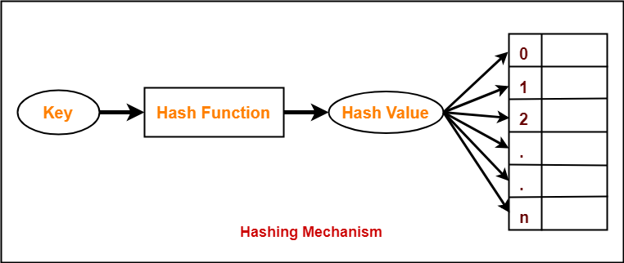
HASH FUNCTION
Hash Function
Hash function takes the data item as
an input and returns a small integer
value as an output.
The small integer value is called as a
hash value.
Hash value of the data item is then
used as an index for storing it into
the hash table.
Types of Hash Functions
There are various types of hash functions available such as:
Mid Square Hash Function
Division Hash Function
Folding Hash Function etc
It depends on the user which hash function he wants to use.
Properties of Hash Function
The properties of a good hash function are-
It is efficiently computable.
It minimizes the number of collisions.
It distributes the keys uniformly over the table.
Hash function is a function that maps any big number or string to a small integer value.

Slide 37
Mid Square Method
HASH FUNCTION - MID SQUARE METHOD
Key K is squared
Hash value is obtained by deleting some digits from both ends of k².
f(k) = specificDigits(k²)
Example:
Keys: 125, 225, 325
f(125) = specificDigits(15625, 2,3) = 56
f(225) = specificDigits(50625, 2,3) = 06
f(325) = specificDigits(105625, 2,3) = 05

Slide 38
Division Method
HASH FUNCTION - DIVISION METHOD
Hash key is the remainder obtained when the key k is divided by some m, where m is the number of buckets.
f(k) = k modulo m
Example
Keys: 123, 224, 325
m: 10
f(123) = 123 mod 10 = 3
f(224) = 224 mod 10 = 4
f(325) = 325 mod 10 = 5

Slide 39
Folding Method
HASH FUNCTION - FOLDING METHOD
Chopping the key into two parts and add them to get the hash address.
Example:
Key: 125, 225, 325
f(125) = 01 + 25 = 26
f(225) = 02 + 25 = 27
f(325) = 03 + 25 = 28

Slide 40
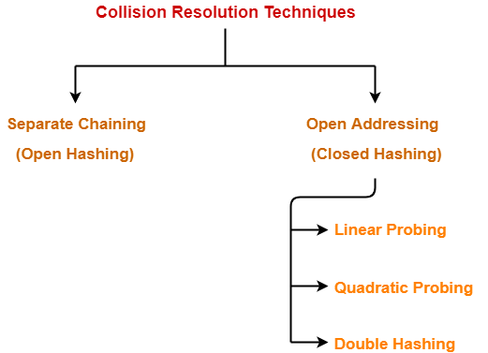
COLLISION RESOLUTION TECHNIQUES
Collision in Hashing-
In hashing,
Hash function is used to compute the
hash value for a key.
Hash value is then used as an index to
store the key in the hash table.
Hash function may return the same hash
value for two or more keys.
When the hash value of a key maps to an already occupied bucket of the hash table,
it is called as a Collision.
Collision Resolution Techniques-
Collision Resolution Techniques are the techniques used for resolving or handling the collision.
Notes:
https://www.gatevidyalay.com/collision-resolution-techniques-separate-chaining/

Slide 41
Collision
COLLISION RESOLUTION TECHNIQUES
Hash collisions are practically unavoidable when hashing a random subset of a large set of possible keys.
For example, if 2,450 keys are hashed into a million buckets, even with a perfectly uniform random distribution, there is approximately a 95% chance of at least two of the keys being hashed to the same slot.
Therefore, almost all hash table implementations have some collision resolution strategy to handle such events.
All the collision avoidance methods require that the keys (or pointers to them) be stored in the table, together with the associated values.
Techniques:
Chaining
Open Addressing
Double Hashing

Slide 42
Chaining
CRT – CHAINING / OPEN HASHING
Buckets are implemented using linked lists.
If there is a collision, then a new node is created and added at the end of the bucket.
All he records with the same hash address may by linked together to form a linked list.
In chaining, the entries are inserted as nodes in a linked list.
The hash table itself is an array of head pointers.
SEPARATE CHAINING
Each bucket is independent
List of entries with the same index.
Hash table operations =
time to find the bucket + time for the list operation

Slide 43
CRT – separate chaining with Linked List
Separate Chaining with Linked Lists
Buckets
Entries
Keys
000 | X
001
002 | X
… | …
151 | X
152
153
154 | X
… | …
251 | X
252
253 | X
X | Key 5 | 37110001
Key 1
 | Key 2 | 37110002
Key 2
X | Key 1 | 37110600
Key 3
X | Key 4 | 37110573
Key 4
Key 5
X | Key 3 | 37110004

Slide 44
Disadvantages
CRT – separate chaining with Linked List Disadvantages
Linked lists will be extended
Longer lists results in decreased performance during insertion / deletion / querying
Memory (pointers)
Worst Case
When all the nodes are pointed to one linked list!!
Bad Hash function

Slide 45
CRT – LINEAR PROBING
The insertion algorithm is as follows:
use hash function to find index for a record
If the spot is already in use, use the next available spot in a "higher" index.
Treat the hash table as if it is a cycle, when end of the hash table is reached, then proceed to the front
Each contiguous group of records (groups of record in adjacent indices without any empty spots) in the table is called a cluster.

Slide 46
Example
CRT – LINEAR PROBING
Example:
Key | Hash | Array Index | Linear Probing
1 | 1 Mod 20 | 1 | 1
2 | 2 Mod 20 | 2 | 2
42 | 42 Mod 20 | 2 | 3
4 | 4 Mod 20 | 4 | 4
12 | 12 Mod 20 | 12 | 12
14 | 14 Mod 20 | 14 | 14
17 | 17 Mod 20 | 17 | 17
13 | 13 Mod 20 | 13 | 13
37 | 37 Mod 20 | 17 | 18

Slide 47
Quadratic Probing
CRT – QUADRATIC PROBING
Quadratic Probing attempt to find ways to reduce the size of the cluster that are formed by linear probing.
Quadratic Probing is similar to Linear probing.
The difference is that when trying to insert into a space that is filled, first check
First 1² ​​=1 element away
Second 2² = 4 elements away
Third 3² =9 elements away
Fourth 4²=16 elements away
and so on.

Slide 48
Example
CRT – QUADRATIC PROBING
Example:
Hash Table Size = 16
Assume that the first 5 keys of data hash to the index 3.
First Key occupies the index: 3
Second Key indexed at ((3 + 1) modulo 16) = 4
Third Key indexed at ((3 + 4) modulo 16) = 7
Fourth Key indexed at ((3 + 9) modulo 16) = 12
Fifth Key indexed at ((3 + 16) modulo 16) = 3 → occupied. Search for an alternative empty spot.
Suggestions:
Be a prime number
Not to fill more than half full by an element

Slide 49
Double Hashing
CRT – DOUBLE HASHING
Double Hashing works similar to linear and quadratic probing.
Uses a big table and hash into it.
Whenever a collision occurs, select another spot in table to place the value.
The difference here is that instead of choosing next opening, a second hash function is used to determine the location of the next spot.
For example, Given Hash Function H1 and H2 and key. Then:
Check location H1(key). If it is empty, place the record in it.
If it is not empty calculate H2(key).
check if H1(key)+H2(key) is open, if it is, place it in
repeat with H1(key)+2H2(key), H1(key)+3H2(key) and so on, until the next empty bucket is found.

Slide 50
SETS
SETS
Set is a collection of objects not in any particular order
Set without any element is called null set or empty set
S = {} (Empty Set)
Sets
Static or Frozen Sets
Sets once constructed will not modify its elements.
Example includes:
Check the occurrence of an element
Enumerate the values in some arbitrary order
Dynamic or Mutable Sets
Insertion / Deletion can be performed on the set.

Slide 51
Sets
SETS
Rules
Duplication of elements are not permitted
There should be relation among the elements in the set.
Example
Set of Prime Numbers: P = {1,2,3,5,7,11,13,17,19,…}
Set of Weeks W = {Sun, Mon, Tue, Wed, Thu, Fri, Sat}
Representation of Sets:
List
Tree
Hash Table
Bit Vectors

Slide 52
Sets as Lists
SETS AS LIST
Dynamic Storage
Allows multiplicity of elements
Good in computational performance
Example:
W = {Sun, Mon, Tue, Wed, Thu, Fri, Sat}
Sun
Sat
Fri
Thu
Wed
Tue
Mon

Slide 53
Sets as Trees
SETS AS TREES
Each element in the set has the same root
Each element has a pointer to its parent
Can be represented as Binary Trees, Binary Search Trees or Balanced Trees
Example:
P = {1, 2, 3, 5, 7, 11,13, 17, 19}
P
1
2
3
5
7
9
11
13
17
19

Slide 54
Sets as Hash Table
SETS AS HASH TABLE
Elements in the collection are segregated as buckets
Each buckets stores any number of elements
Example:
S = { 4, 19, 11, 17, 22, 16, 29, 20, 18 }
Bucket Size = 4
Bucket 0
4
16
20
Bucket 1
17
29
Bucket 2
22
18
Bucket 3
19
11

Slide 55
Sets as Bit Vector
SETS AS BIT VECTOR
Data is represented as 0 or 1
1 – Existence
0 – Non-Existence
Example:
Age of Cricketers is less than or equal to 25
S = { 0, 0, 0, 1, 1, 0, 0, 1, 1 }
0 – Age <= 25,
1 – Age >= 25
Saves data storage

Slide 56
Basic Set Operations
BASIC SET OPERATIONS
Union (A, B) : A U B
Intersection (A, B) : A ∩ B
Difference (Minus) : A – B
Subset (A, B) : A ⊆ B
Example:
A = { 1, 2, 3, 5, 7, 11, 13, 17, 19 }
B = { 1, 3, 5, 7, 9, 11, 13, 15, 17, 19 }
A U B = { 1, 2, 3, 5, 7, 9, 11, 13, 15, 17, 19 }
A ∩ B = { 1, 3, 5, 7, 11, 13, 17, 19 }
A – B = { 2 }
A ⊆ B = True

Slide 57
Operations on Static Set Structures S
OPERATIONS ON STATIC SET STRUCTURES
is_element_of(x,S): checks whether the value x is in the set S.
is_empty(S): checks whether the set S is empty.
size(S) or cardinality(S): returns the number of elements in S.
iterate(S): returns a function that returns one more value of S at each call, in some arbitrary order.
enumerate(S): returns a list containing the elements of S in some arbitrary order.
build(x₁, x₂,…, x_{n}): creates a set structure with values x₁, x₂,…, x_{n}
create_from(collection): creates a new set structure containing all the elements of the given collection or all the elements returned by the given iterator.

Slide 58
Operations on Dynamic Set Structures S
OPERATIONS ON DYNAMIC SET STRUCTURES
create(): creates a new, initially empty set structure.
create_with_capacity(n): creates a new set structure, initially empty but capable of holding up to n elements.
add(S,x): adds the element x to S, if it is not present already.
remove(S, x): removes the element x from S, if it is present.
capacity(S): returns the maximum number of values that S can hold.
pop(S): returns an arbitrary element of S, deleting it from S.
pick(S): returns an arbitrary element of S. Functionally, the mutator pop can be interpreted as the pair of selectors (pick, rest), where rest returns the set consisting of all elements except for the arbitrary element. Can be interpreted in terms of iterate.
map(F,S): returns the set of distinct values resulting from applying function F to each element of S.

Slide 59
Operations Contd..
OPERATIONS ON DYNAMIC SET STRUCTURES
filter(P, S): returns the subset containing all elements of S that satisfy a given predicate P.
fold(A₀,F,S): returns the value A_{S} after applying A_{i+1} := F(A_{i}, e) for each element e of S, for some binary operation F. F must be associative and commutative for this to be well-defined.
clear(S): delete all elements of S.
equal(S₁, S₂): checks whether the two given sets are equal (contain all and only the same elements).
hash(S): returns a hash value for the static set S such that if equal(S₁, S₂) then hash(S₁) = hash(S₂)

